Slide 1


Dog Breed Suitability for Families Project
By: Quintin Covington, Daquan Morrison, Zachary Blaine - Atkins
Notes:
For our project we explored the suitability of dog breeds for potential owners by categorizing breeds based on key attributes that align with owners’ lifestyle needs.

Slide 2

Problem Statement
Problem Definition: Our project classifies dog breeds into categories optimal for potential owners based on key characteristics aiming to match breeds with specific family lifestyles. This improves compatibility and decision-making for prospective dog owners, fostering enduring relationships and minimizing abandonment risks.
Business Application: This classification model can be adopted by pet adoption agencies, breeders, and pet supply stores to recommend breeds to potential owners, enhancing the chances of successful, lasting matches and increasing customer satisfaction while reducing pet abandonment rates.
Notes:
Our goal was to identify strong correlations in our dog dataset to optimize the match between dog breeds and potential owners based on lifestyle types.
This application will enable pet adoption agencies, breeders, and stores to make well informed decisions tailored to their customers lifestyles and family dynamics.

Slide 3
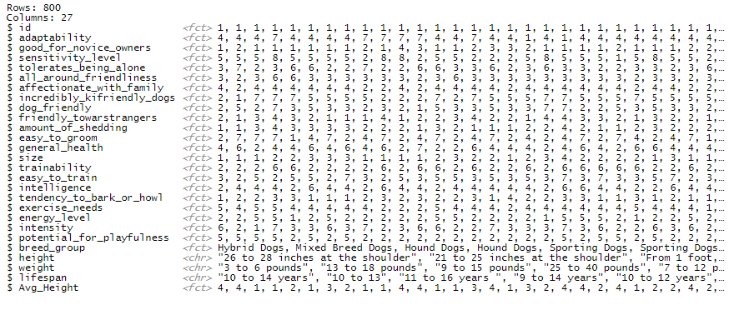
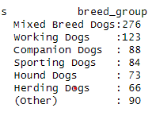
Data Overview
Notes:
Here is a snapshot of our data frame.
It includes 800 dog breeds, each categorized into specific breed groups with 27 attributes such as adaptability, intelligence, trainability, and lifespan.

Slide 4
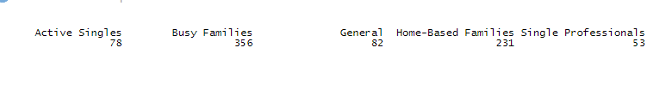
Lifestyle-Based Dog Breed Model
Combining Categories for Nuanced Classification:
Integrating family composition and work schedule for more accurate lifestyle categories.
Busy Families:
Owners: Working parents or those with active family lives.
Ideal Breeds: Independent yet friendly and energetic dogs.
Single Professionals:
Owners: Single, full-time workers often away from home.
Ideal Breeds: Lower maintenance, content with companionship.
Retired Couples/ Home Based Families
Owners: Retired or individuals who work remote that can spend ample time at home.
Ideal Breeds: Less active, smaller size, companionship-oriented.
Active Singles:
Owners: Urban/suburban dwellers with active lifestyles.
Ideal Breeds: Match owner's activity level for outdoor adventures.
Enhanced Model Relevance and Utility:
Tailoring dog breed recommendations to specific lifestyles and living situations of potential owners.
Notes:
Our First step after cleaning our data was modifying our data frame by introducing a 'lifestyle_category' column, classifying all dog breeds into four lifestyle categories based on behavior traits:
We have 'Busy Families,' 'Single Professionals,' 'Home-Based Families,' 'Active Singles,' plus a 'General' category for dogs that did not fit any of the 4 criteria .
For example, our 'Home-Based Families' features dogs with lower tolerance for being alone but higher energy levels compared to 'Single Professionals' and 'Busy Families.
Below you can see the output of our classification.

Slide 5

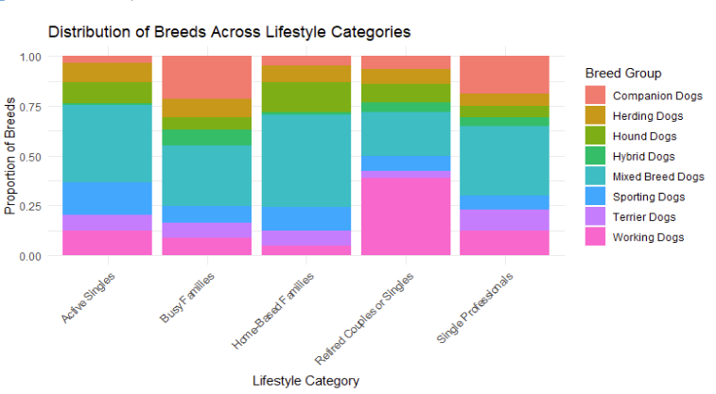



Notes:
This stacked bar chart shows the distribution of the various dog breeds across all 4 lifestyle categories
We can see that Mixed Breed are very prominent in all 4 categories
Terrier Dogs and Companion Dogs are popular with active singles and single professional.
Busy Families and Home-Based Families: Both have a pretty balanced distribution overall.
For Retirees: Companion Dogs and Hybrid Dogs are recommended due to their manageable size and easygoing nature.

Slide 6
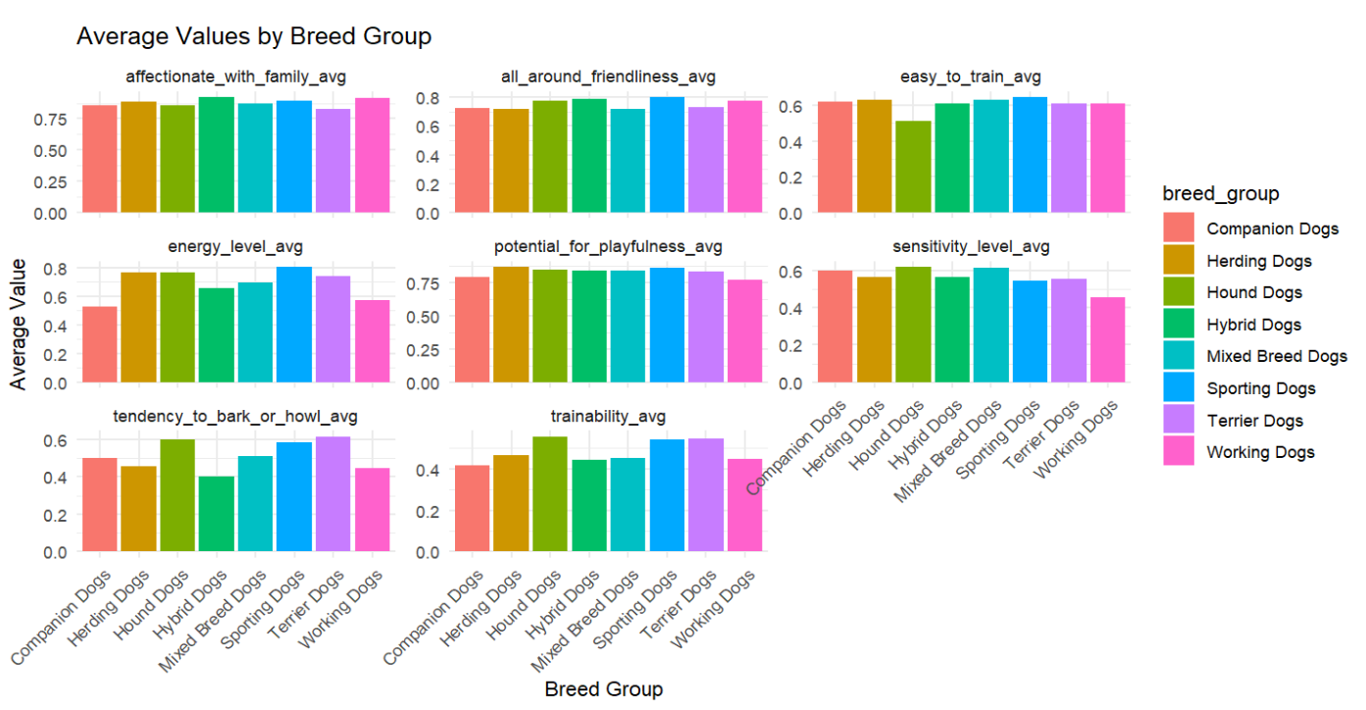
Exploratory Data Analysis

Slide 7
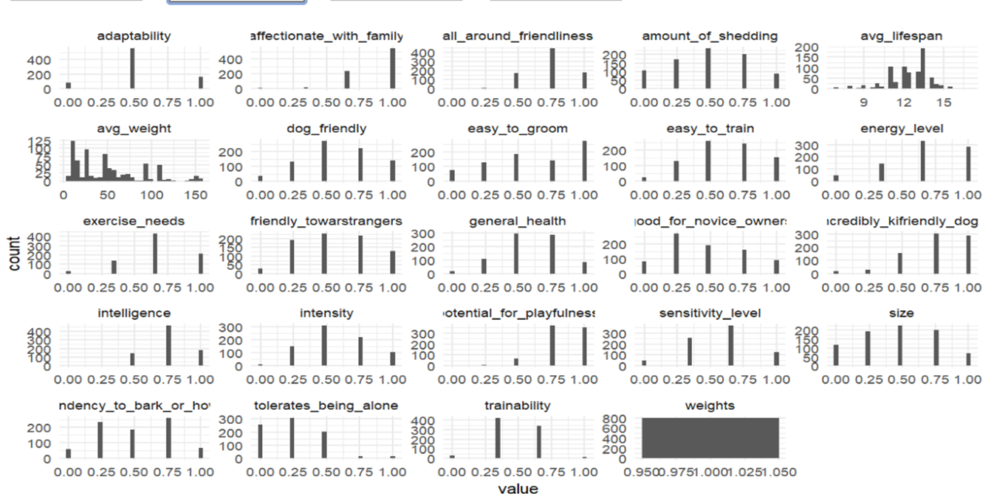
Notes:
The plot shows the distribution of various dog breed traits, with each facet representing a different trait.
Key points:
The x-axis of each facet shows the value range for the trait (0 to 1).
The y-axis shows the count of occurrences for each value range.
Traits like "adaptability," "affectionate_with_family," "dog_friendly," and "trainability" show a relatively even distribution across their value ranges.
Traits such as "amount_of_shedding," "intensity," and "tendency_to_bark_or_howl" show more distinct peaks, indicating certain common value ranges for these traits.
Each trait's histogram reveals the diversity and frequency of traits among the dog breeds in the dataset.
In summary, the plot highlights how different traits vary among dog breeds, with some traits being more evenly distributed and others having specific common values.

Slide 8
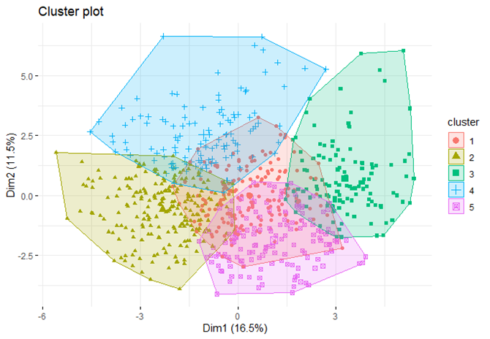
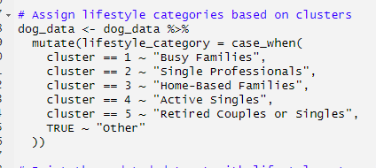
Cluster Plot

Slide 9
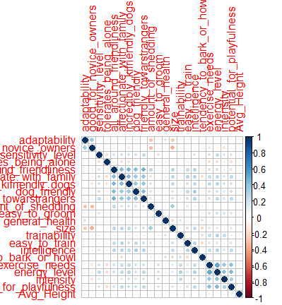
Correlation Matrix
Positive(Blue)
Negative (Orange)
No Correlation (Blank/Dim)
Notes:
Adaptability:
Strongly correlated with "good_for_novice_owners" and "all_around_friendliness".
Energy Level:
May show varying degrees of correlation with variables like "exercise_needs" and "intensity".
Negative:
"amount_of_shedding" might have a negative correlation with "easy_to_groom".
This information can be useful for prospective dog owners looking for specific characteristics and for understanding how different traits interact with one another.

Slide 10
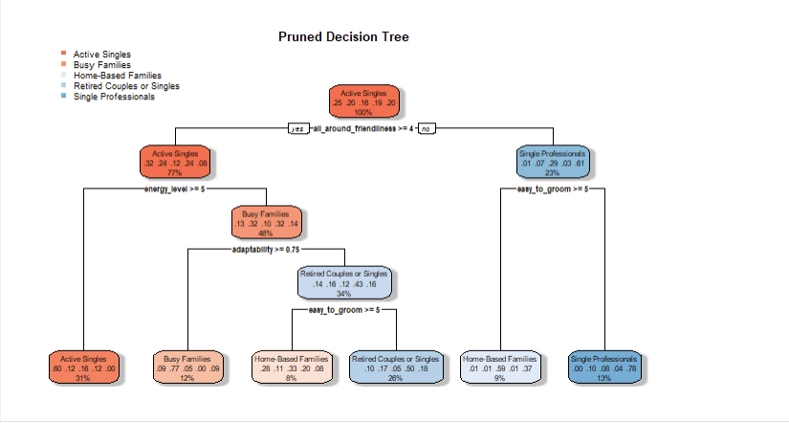
Notes:
Decision Tree Model
Overview
The decision tree model was trained to predict dog breed lifestyle categories using attributes like energy level and friendliness. We used 5-fold cross-validation to tune the complexity parameter (CP).
Results
Root Node Error: 0.75375
Optimal CP: 0.005, leading to a tree with 5 splits.
Cross-Validation Error: 0.57048 (Std. Dev: 0.023222)
Interpretation
Pruning improved the model's generalization. Key predictors were adaptability, friendliness, grooming ease, and energy level. The model's error indicates room for accuracy improvement.
Model Improvement
Feature Engineering: Adding more relevant features or transforming existing ones might improve performance.
Ensemble Methods: Using techniques like boosting (e.g., Gradient Boosting) could enhance model accuracy.
Hyperparameter Tuning: Further fine-tuning of parameters beyond CP, such as max depth or minimum samples split, could yield better results.

Slide 11
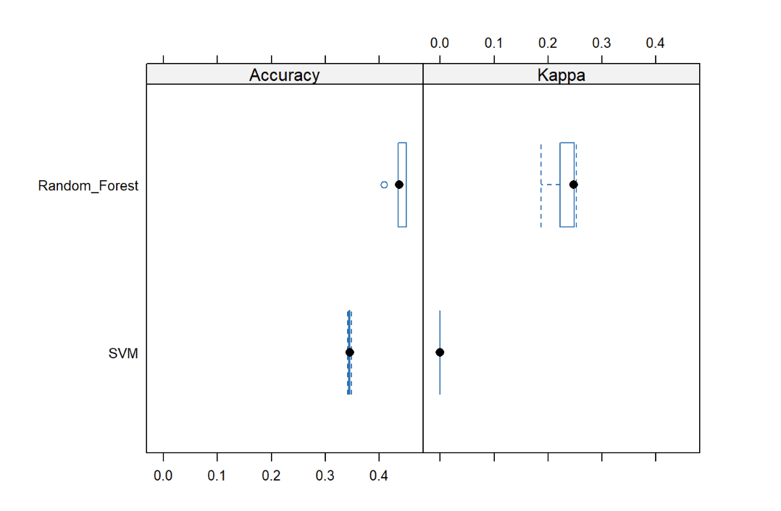
Random Forest & SVM
Notes:
Random Forest Model
Overview
The random forest model also predicted lifestyle categories. We optimized the number of variables sampled at each split (mtry) using 5-fold cross-validation.
Results
Accuracy:
Range: 0.4088 to 0.4500
Median: 0.4375
Kappa:
Range: 0.1874 to 0.2528
Median: 0.2479
Optimal mtry: 321, with accuracy 0.4362 and Kappa 0.2317.
Interpretation
The model performed consistently across folds. The chosen mtry balanced variance and bias, and the moderate Kappa reflected good handling of class imbalance.
Model Improvement
More Trees: Increasing the number of trees in the forest could improve stability and accuracy.
Feature Selection: Removing less important features could reduce noise and enhance performance.
Different Splitting Criteria: Experimenting with criteria like entropy instead of Gini could offer performance gains
Support Vector Machine (SVM) Model
Overview
We used an SVM with a radial basis function kernel, tuning sigma and C through grid search and cross-validation.
Results
Optimal Parameters: Sigma = 0.002667, C = 0.25
Accuracy:
Range: 0.3416 to 0.3481
Median: 0.3457
Kappa: 0.0000 across all folds
Interpretation
The SVM struggled, as shown by the low Kappa values, indicating poor classification ability. The low accuracy suggests a need for alternative methods or feature engineering.
Model Improvement
Kernel Functions: Trying different kernels (e.g., polynomial, sigmoid) might better capture data patterns.
Scaling Features: Ensuring all features are properly scaled can significantly impact SVM performance.
Dimensionality Reduction: Using techniques like PCA to reduce feature dimensions could help improve accuracy by focusing on the most important aspects of the data.
Comparative Analysis
Accuracy
Random Forest: 0.4362 (Median)
SVM: 0.3457 (Median)
Decision Tree: Error reduction post-pruning, not directly comparable.
Kappa
Random Forest: 0.2479 (Median)
SVM: 0.0000 (Median)
Decision Tree: Not directly provided.
Summary
The Random Forest model outperformed SVM model in accuracy and Kappa, making it the most effective for classifying dog breeds into lifestyle categories. The SVM model performed the worst, highlighting the need for different preprocessing or modeling approaches.

Slide 12
Recommendations
Active Families
Recommended Breeds:
Sporting Dogs: Ideal for families who enjoy outdoor activities like hiking, running, or playing sports.
Secondary Options: Mixed-breed, Hound, and Working dogs.
Busy Families & Single Professionals
Recommended Breeds for Busy Families:
Companion, Hybrid, and Mixed Breeds: Require less physical activity and are content with shorter, leisurely walks.
Recommended Breeds for Single Professionals:
Terriers, Companion, and Mixed Breeds: Offer emotional support and companionship with manageable exercise needs.
Notes:
Active Families
Recommended Breeds:
Sporting Dogs: Ideal for families who enjoy outdoor activities like hiking, running, or playing sports.
Secondary Options: Mixed-breed, Hound, and Working dogs.
Busy Families & Single Professionals
Recommended Breeds for Busy Families:
Companion, Hybrid, and Mixed Breeds: Require less physical activity and are content with shorter, leisurely walks.
Recommended Breeds for Single Professionals:
Terriers, Companion, and Mixed Breeds: Offer emotional support and companionship with manageable exercise needs.

Slide 13
Recommendations
Home-Based Families with Young Children & Retired Couples
Recommended Breeds for Home-Based Families:
Hounds (preferred), Mixed-breeds, and Sporting Dogs: Friendly, tolerant, and protective.
Recommended Breeds for Retired Couples:
Hound Dogs, Mixed Breeds, and Some Working Dogs: Ensure a stable and nurturing environment.
Additional Criteria: Utilize correlation matrix and exploratory data analysis for further refinement (e.g., ease of grooming).
Notes:
Home-Based Families with Young Children & Retired Couples
Recommended Breeds for Home-Based Families:
Hounds (preferred), Mixed-breeds, and Sporting Dogs: Friendly, tolerant, and protective.
Recommended Breeds for Retired Couples:
Hound Dogs, Mixed Breeds, and Some Working Dogs: Ensure a stable and nurturing environment.
Additional Criteria: Utilize correlation matrix and exploratory data analysis for further refinement (e.g., ease of grooming).

